Slide 1
Opening the black box of Deep Neural Networks via Information
Ravid Schwartz-Ziv, Naftali Tishby

Slide 2
In a nutshell
Introduce how the author model the convolutional neural network with information theory.
Describe the experiment setting.
Observe the variables in information theory with experiment.
Analyze the benefit of hidden layers and training set size in CNN.

Slide 3
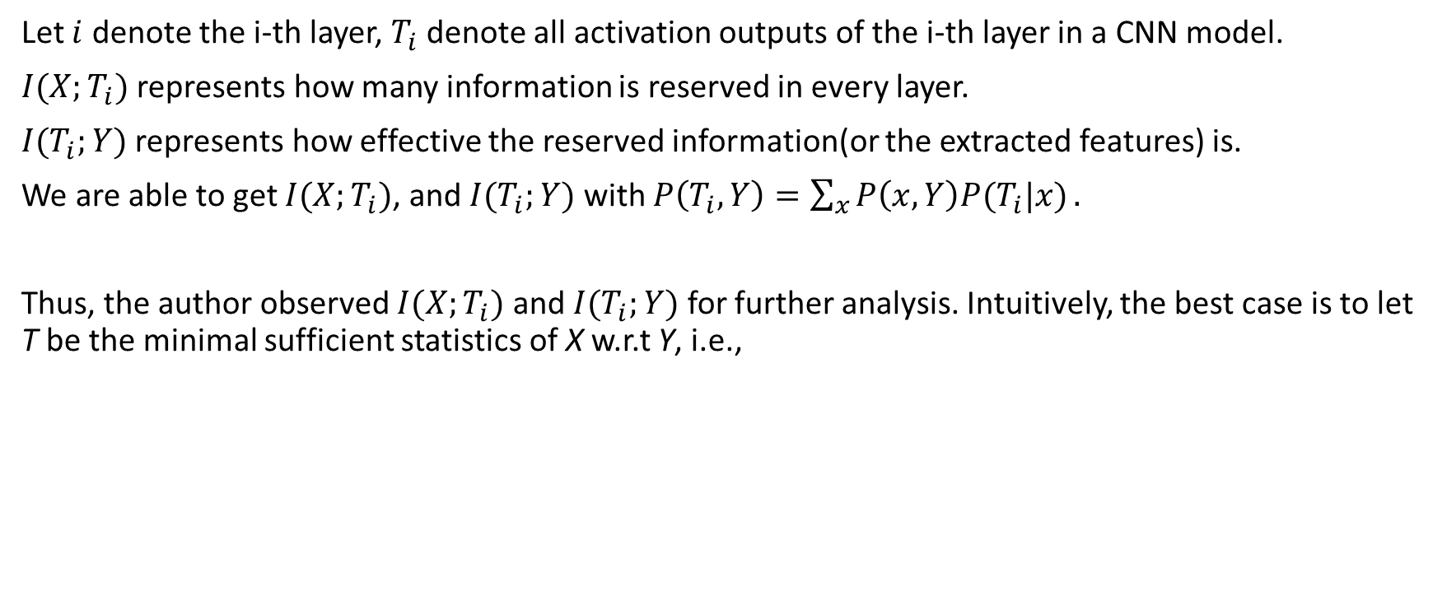
Model CNN with information theory
Let $i$ denote the i-th layer, $T_{i}$ denote all activation outputs of the i-th layer in a CNN model.
$I(X;T_{i})$ represents how many information is reserved in every layer.
$I(T_{i};Y)$ represents how effective the reserved information(or the extracted features) is.
We are able to get $I(X;T_{i})$, and $I(T_{i};Y)$ with $P\left(T_{i},Y\right)=\sum_{x}{P\left(x,Y\right)P(T_{i}|x)}.$
Thus, the author observed $I(X;T_{i})$ and $I(T_{i};Y)$ for further analysis. Intuitively, the best case is to let T be the minimal sufficient statistics of X w.r.t Y, i.e.,

Slide 4
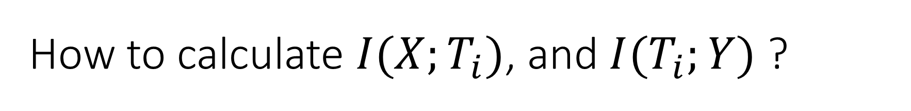
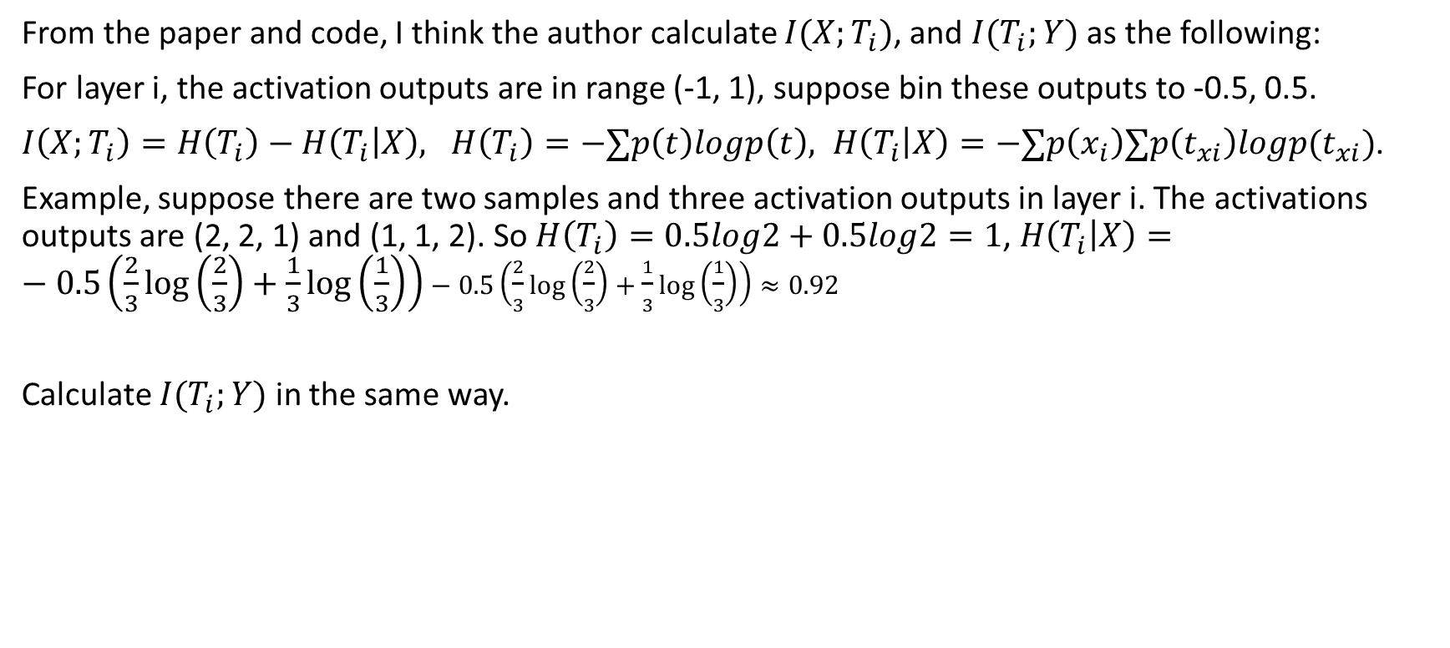
How to calculate $I(X;T_{i})$, and $I(T_{i};Y)$ ?
From the paper and code, I think the author calculate $I(X;T_{i})$, and $I(T_{i};Y)$ as the following:
For layer i, the activation outputs are in range (-1, 1), suppose bin these outputs to -0.5, 0.5.
$I\left(X;T_{i}\right)=H\left(T_{i}\right)−H\left(T_{i} | X\right), H\left(T_{i}\right)=−∑p\left(t\right)logp\left(t\right), H\left(T_{i} | X\right)=−∑p\left(x_{i}\right)∑p\left(t_{xi}\right)logp(t_{xi})$.
Example, suppose there are two samples and three activation outputs in layer i. The activations outputs are (2, 2, 1) and (1, 1, 2). So $H\left(T_{i}\right)=0.5log2+0.5log2=1$, $H\left(T_{i} | X\right)=−0.5\left(\frac{2}{3}log\left(\frac{2}{3}\right)+\frac{1}{3}\log\left(\frac{1}{3}\right)\right)−0.5\left(\frac{2}{3}log\left(\frac{2}{3}\right)+\frac{1}{3}\log\left(\frac{1}{3}\right)\right)≈0.92$
Calculate $I(T_{i};Y)$ in the same way.

Slide 5
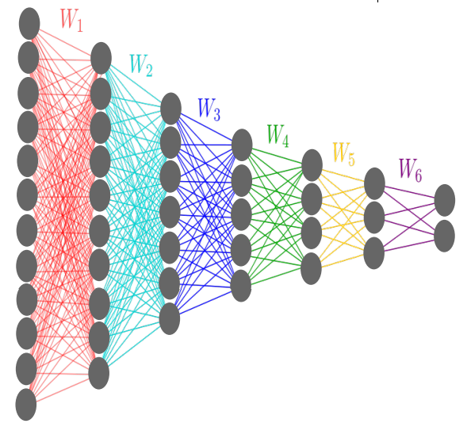
Experiment setting
Network structure: the DNNs used have up to 7
fully connected hidden layers(no weight share here),
with widths: 12-10-7-5-4-3-2 neurons. So the
network is quite simple. According to the paper,
the training data is points on a 2D sphere, and its
size is up to 4096.
But according to the code, mnist dataset is used,
and weights share can be applied.

Slide 6
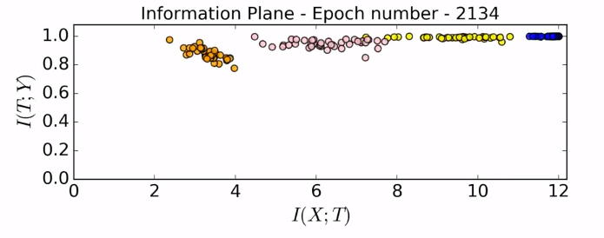
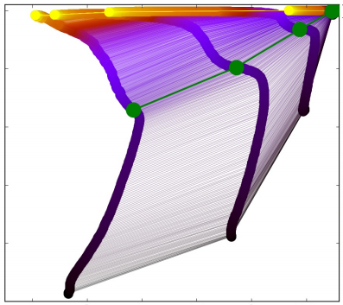
I(X;T) and I(T;Y) observations
video here, https://goo.gl/rygyIT Before watch it, note(to help understand the video)
i. In the snapshot(left), points in different color represents different layer. From right to left, the id of layer increase(you can get this with data processing inequality). Points with the same color represents the same layer in different initialized network.
ii. Here is a curve(sharp turn) of these points’ path, like the right picture.

Slide 7
I(X;T) and I(T;Y) observations
From the video, I(X;T) is increasing, then decreasing, while in the whole
process, I(T;Y) is monotonically increasing. Just like the right picture.
The two parts of I(X;T) are called as empirical error minimization(ERM),
and representation compression.
Where does the increase of I(T;Y) come from?

Slide 8
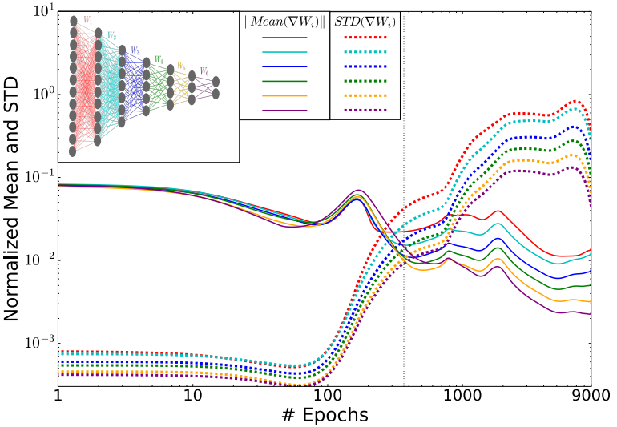
Sake of I(T;Y)’s increase
To find the sake of I(T;Y)’s increase, the
author observed the behavior of the
stochastic gradients along the epochs.
Figure: The L2 norm(signal) of the means and standard
deviations(noise) of the weights gradients for each
layer, as function of the number of training epochs (in
log scale).
The deviations/noise comes from batch,
since the batch is only a small part of the whole training set.

Slide 9
Digression: what’s the best batch size?
If we let the batch size larger, the deviations/noise should be smaller, but is it good?
According to Andrew Ng’s online course, if we can, the batch should be the whole training set because we want to get gradient on the whole training set, i.e., we want to get the best performance on the whole training set, not only the batch.
According to [1], ‘large-batch methods tend to converge to sharp minimizers of the training and testing functions—and as is well known, sharp minima lead to poorer generalization.’
[1] Nitish Shirish Keskar etc.al., On Large-Batch Training for Deep Learning: Generalization Gap and Sharp Minima, ICLR 2017

Slide 10
Sake of I(T;Y)’s increase
In the picture, before the gray line(empirical
error minimization), norms of weights
gradients is more dominated than deviations
(high SNR). So it can be interpreted with
empirical error minimization.
But after the gray line(representation
compression), it’s very strange why though
norms of weights gradients is less dominated
than deviations(low SNR), I(T;Y) still
increases?

Slide 11
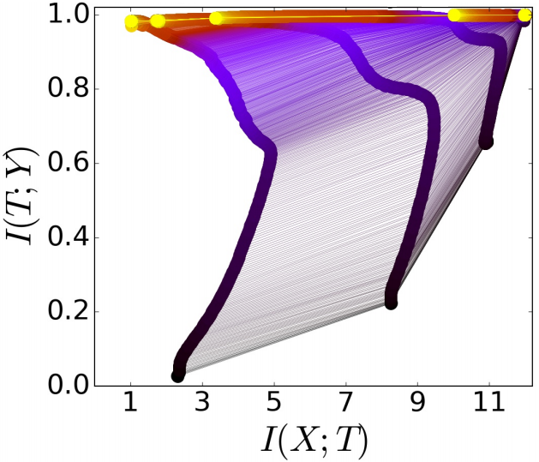

Sake of I(T;Y)’s increase
The author only gives an interpretation on I(T;X)’s decrease at
the second phase. But doesn’t explain the increase of I(T;Y).
Interpretation on I(T;X)’s decrease at the second phase:
In this phase, norms of weights gradients is less dominated
than deviations(low SNR), which can be seen as adding random
noise to the weights. This evolve like Wiener processes, under
the training error or label information constraint, which can be
described by Fokker Planck equation, whose stationary
distribution maximizes the entropy of the weights distribution,
under the training error constraint. That in turn maximizes the conditional entropy, $H(X|T_{i})$, or minimizes the
mutual information $I\left(X;T_{i}\right)=H\left(X\right)−H\left(X | T_{i}\right).$

Slide 12
Sake of I(T;Y)’s increase
The author only gives an interpretation on I(T;X)’s decrease at
the second phase. But doesn’t explicitly explain the increase
of I(T;Y).
My interpretation on I(T;Y)’s increase at the second phase:
Maybe we can think the least I(T;X) as the minimal sufficient
statistics of X w.r.t Y. It means that the network extracts all
relevant information or features in the input patterns X, and
contains no irrelevant Information or features. Thus the
network is of good generalization. In this view, (i) the ‘broad’
of training set is very important, which in a sense explains why data augmentation is effective since it try to make the sample/training distribution closer to the real distribution in the wild. (ii) the closer between training and test set, the better performance.

Slide 13
The benefit of hidden layers
Many models were motivated by making the network deeper, for example, ResNet[2]. But shallow network with larger width has the same number of parameters of deeper network. Furthermore, in my opinion, shallow network with larger width should have shorter time in test phase.
The author trained networks with 1 to 6 hidden layers to observe the benefit of the hidden layers.
Observations of this experiment:
Adding hidden layers dramatically reduces the number of training epochs for good generalization. In practice, you should use some tricks to make the network converge or gain good convergence performance when add more hidden layers in practice.
The compression phase of each layer is shorter when it starts from a previous compressed layer
The compression is faster for the deeper (narrower and closer to the output) layers.
[2] He, Kaiming, et al. "Deep residual learning for image recognition." CVPR 2016

Slide 14
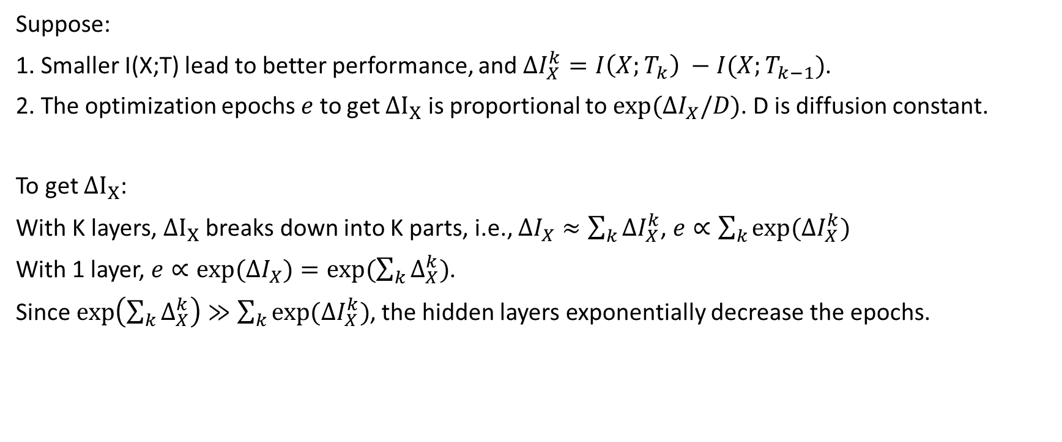
The benefit of hidden layers
Suppose:
1. Smaller I(X;T) lead to better performance, and $ΔI_{X}^{k}=I\left(X;T_{k}\right) −I(X;T_{k−1})$.
2. The optimization epochs $e$ to get $ΔI_{X}$ is proportional to $exp⁡(ΔI_{X}/D)$. D is diffusion constant.
To get $ΔI_{X}$:
With K layers, $ΔI_{X}$ breaks down into K parts, i.e., $ΔI_{X}≈\sum_{k}{ΔI_{X}^{k}}$, $e∝\sum_{k}{exp⁡(ΔI_{X}^{k})}$
With 1 layer, $e∝\exp{(ΔI_{X})}=exp⁡(\sum_{k}{Δ_{X}^{k}})$.
Since $\exp\left(\sum_{k}{Δ_{X}^{k}}\right)≫$ $\sum_{k}{exp⁡(ΔI_{X}^{k})}$, the hidden layers exponentially decrease the epochs.

Slide 15
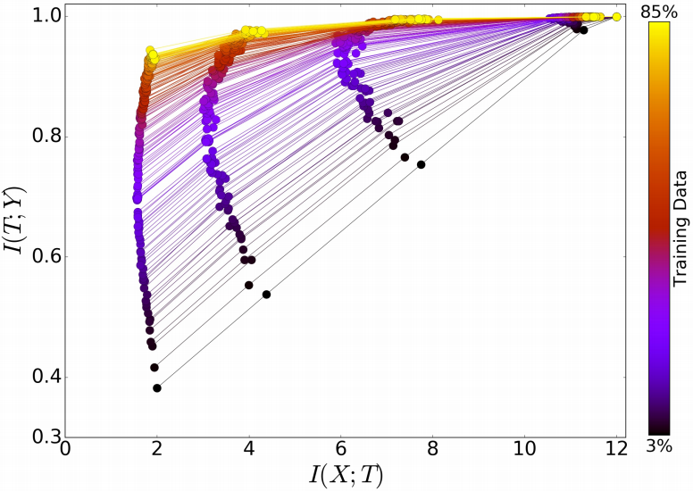
The benefit of training size
The author trained networks of 6 hidden layers with different training size to observe the benefit of the training size. Note the largest training size is 3482. From the picture,
Larger the training size, larger I(T;Y) in the
higher layers, but I(X;T) hardly change with
different training size.
I(T;Y) in the lower layers hardly change with
different training size.

